Slide 1
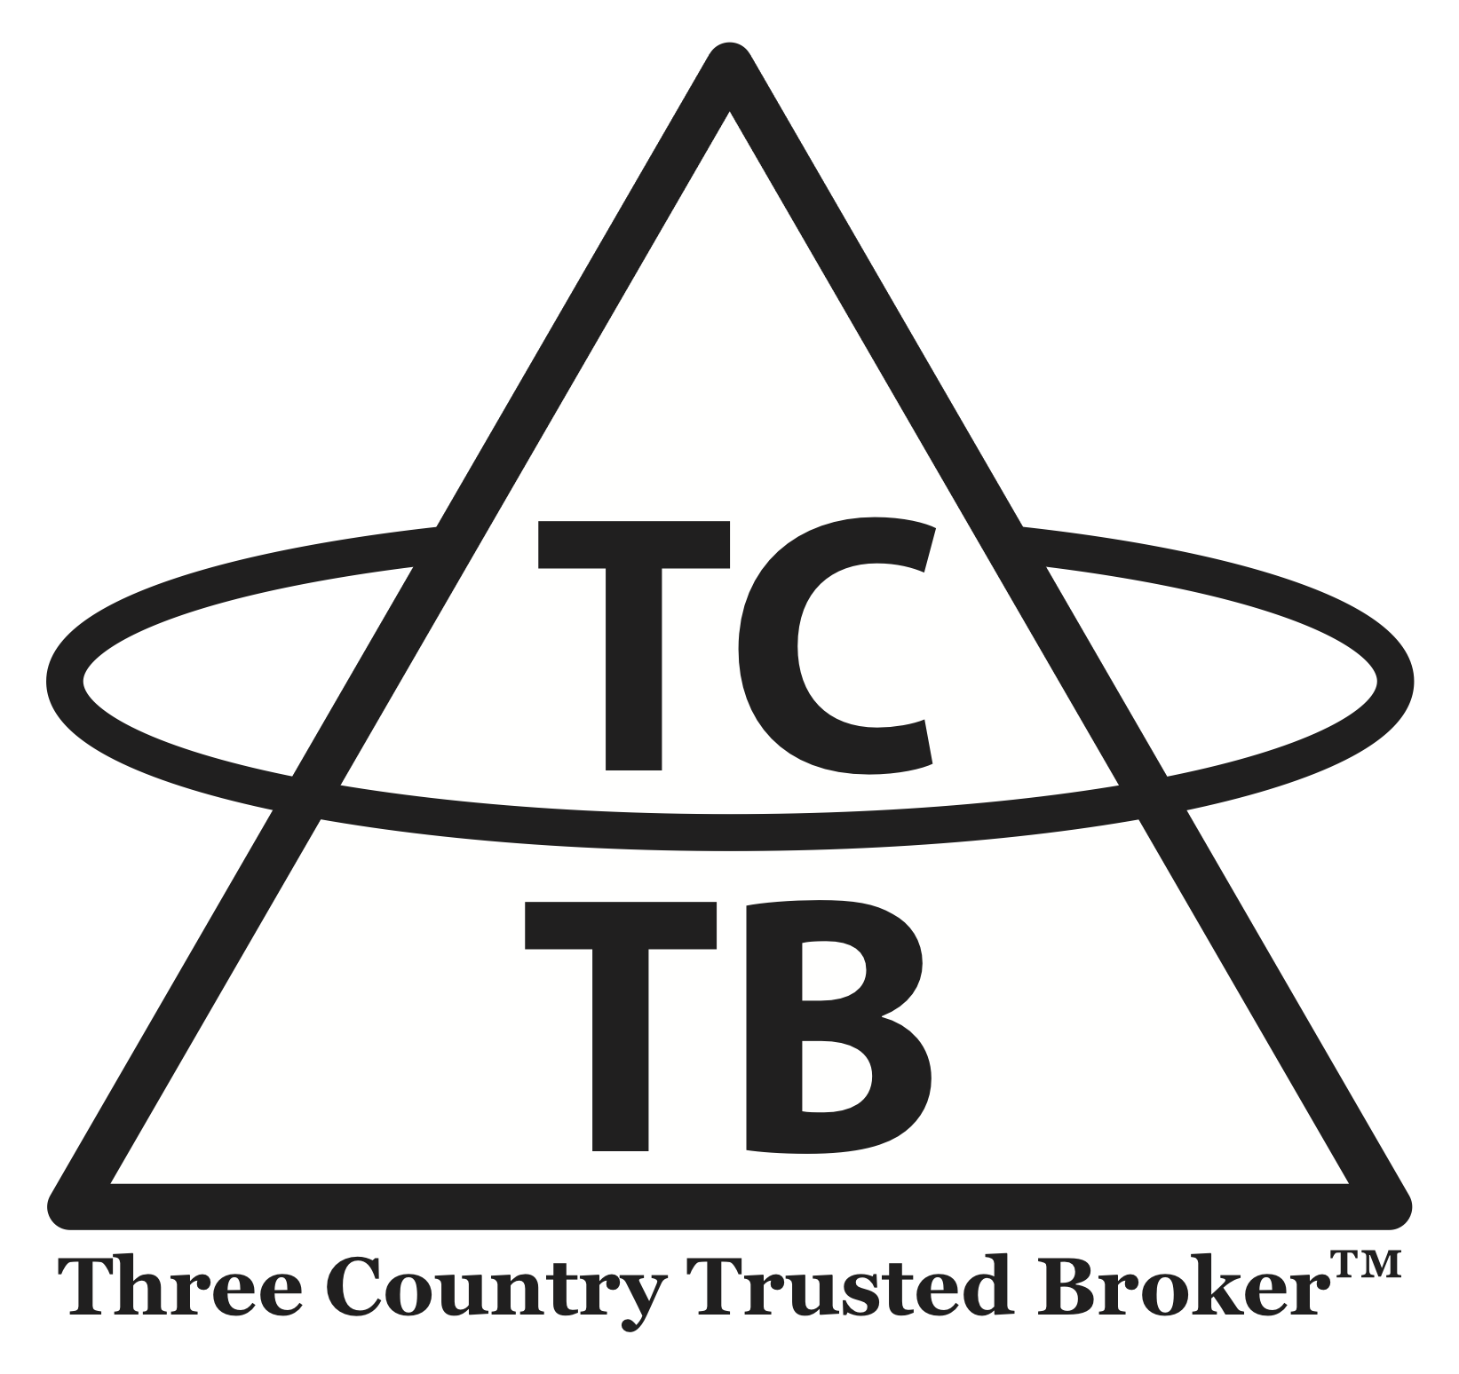
United Nations Committee on the Peaceful Uses of Outer Space, 66th Session, June 6, 2023
Technical Presentation
“TCTB: Facilitating Cooperative Remediation of Massive Derelicts”
Chuck Dickey (United States of America)
Valentin Uvarov (Russian Federation)
Guoyu Wang (China)
Notes:
Distinguished Delegates, Chair and Secretariat:
TCTB is an acronym for “Three Country - Trusted Broker”, which describes its simple purpose in a few words – to act as a “mediator” to facilitate cooperation among the handful of governments who own the most dangerous debris in space, or Massive Derelicts. We believe using a private, neutral, transparent, non-profit, international non-governmental organization is the only practical way to overcome the legal, political and economic hurdles that have prevented remediation of these objects, before the next collision.

Slide 2
Orbital Debris - Our Shared Problem
Humanity’s future in space is threatened by man-made debris in outer space
Three sizes
  Small: Hundreds of millions of objects
  Medium: Millions of objects
  Large: 36,000+ objects larger than a grapefruit
Most dangerous: “Massive Derelicts” in Upper-LEO
  2000+ objects, 1-10 tons per object, un-maneuverable
  Owned mostly by the Russian Federation, the United States of America, and China
  France, Japan, India and the European Space Agency own a few
  Objects are tightly clustered in orbital shells and travel at high speeds
  Forecast collisions (or explosions) are imminent and will be devastating
Notes:
Of all the debris in space, the most dangerous are a few thousand very large, un-maneuverable objects travelling at very high speeds in clustered orbits between 750 and 1500 km in altitude. These Massive Derelicts are owned mostly by the Russian Federation, the United States of America and China, listed in the order in which they first went to space, along with a few owned by France, Japan, India and the European Space Agency. Forecast collisions involving these objects will increase the likelihood of even more collisions, and will increase the cost and risk of space for everyone, for any purpose. To effectively and efficiently reduce that risk, Russia, China and the US must find a way to work together.

Slide 3
The Case for International Cooperation
Purely national programs, although beneficial and necessary, carry baggage that will inhibit timely, efficient and meaningful risk reduction
  Domestic preferences
  National security constraints
  Ineffective to reduce overall statistical risk
Opportunity versus fault
Share the burden (enables economic efficiency)
Notes:
If each government were limited to remediating its own objects, using its own technology, all of them would have to act simultaneously to meaningfully reduce overall risk. We all know that is highly unlikely; and it would be very inefficient in terms of reducing the most risk for the least cost; and it might be provocative since most remediation technology across the world carries national security implications when used by governments. It’s also important to understand that any fault-based remediation formula where each government is expected to clean up its own legacy debris will not work – cooperation must instead focus on the future each government sees for itself in space – a future that will be enabled by reducing risk. We must find a way to cooperate.

Slide 4
Necessary Building Blocks for Cooperation
A path to cooperative remediation of Massive Derelicts must include:
  Agreement on a framework for cooperation
  Principles of Cooperation
  Planning Process and Timeline
  Performing the Work – remediation mission business model
Notes:
Under any plan to cooperate, the means of cooperation must be agreed upon. Several elements must be discussed regarding how to tackle Massive Derelicts, including a structure for cooperation and principles of cooperation. This will take several years of planning, so it’s important to start now.

Slide 5
Cooperative Structure
Alternative Frameworks
  UN-based arrangement (multilateral)
  Government to government agreements (bilateral)
  Public - Intergovernmental organization (IGO)
  Private-Public - Nongovernmental organization (NGO)
Private-Public International NGO (INGO): The surest path to timely cooperative remediation
  Non-political (neutral)
  Low cost, streamlined, transparent
  Enables economies of scale (efficient)
  No changes to international law required
Notes:
In deciding on a structure for cooperation, there are a number of purely public and public-private alternatives to consider. When you think about the legal, political and economic hurdles to cooperative remediation of Massive Derelicts, acting through an NGO has the best chance of success in time to prevent imminent collisions. Only a politically neutral cooperative approach can overcome domestic preferences, national security imperatives, and the economic constraints that will threaten success.

Slide 6
Necessary Principles of Cooperation
Cost, risk and information sharing during planning and remediation missions
Legal consent
Object selection methodology
Procurement plan
Dispute resolution mechanisms
Protection of sovereign prerogatives
Notes:
Agreeing on shared principles is also important, for example, how to share cost, risk and information during actual missions. We’ve thought about what those principles might look like, and we’ve written a paper about it which includes draft clauses, simply as a starting point for discussions. The paper and the principles are on our website.

Slide 7
Necessary Planning Process and Timeline
Phase 1 – Negotiation of structural agreements including Principles of Cooperation (one year or more)
Phase 2 – Identifying and selecting initial objects for remediation consideration (one year or less)
Phase 3 – Development of contracting process, documents seeking proposals for remediation, evaluation of proposals, negotiation and award of mission contracts (one year or more)
Phase 4 – Performance of initial remediation mission (one year or more)
Phase 5 – Follow-on missions sufficient to provide meaningful risk reduction (several years)
Notes:
The reason why streamlining is important is because of the great length of time it will take to prepare for actual remediation missions. Identifying a structure for cooperation and shared principles are just two pieces of the puzzle. Selecting objects for remediation and in what order, and then developing a fair process to pick the best remediation technology from across the world, will literally take several years. If we want to act before the next forecast collision, and we understand the need to cooperate, we need to start planning together now. By the way, there are some really cool ways to engage stakeholder governments in the remediation process, that we discuss on our website.

Slide 8
Performing the Work – Remediation Model
TCTB’s public-private INGO model facilitates cooperation among governments through its single-issue focus
TCTB’s neutral, multi-jurisdictional structure ensures confidentiality, transparency and trust
TCTB’s model enables efficiency
TCTB’s path is streamlined to meet the urgent need
Examples of similar NGOs include the Red Cross (shared objective of humanitarian aid), and international mediation for cross-border disputes (shared respect for rule of law)
More information about TCTB’s novel path to remediation can be found at threecountrytrustedbroker.com
Notes:
The ultimate goal of planning is to field a program that will actually work to efficiently and effectively reduce overall risk in space in time to make a difference. We believe that cooperation through an international NGO is the best way to do that, as we’ve demonstrated in several papers and presentations in the space community over the last few years, which you can find on our website. This is why TCTB stands before you now, to offer our assistance.

Slide 9
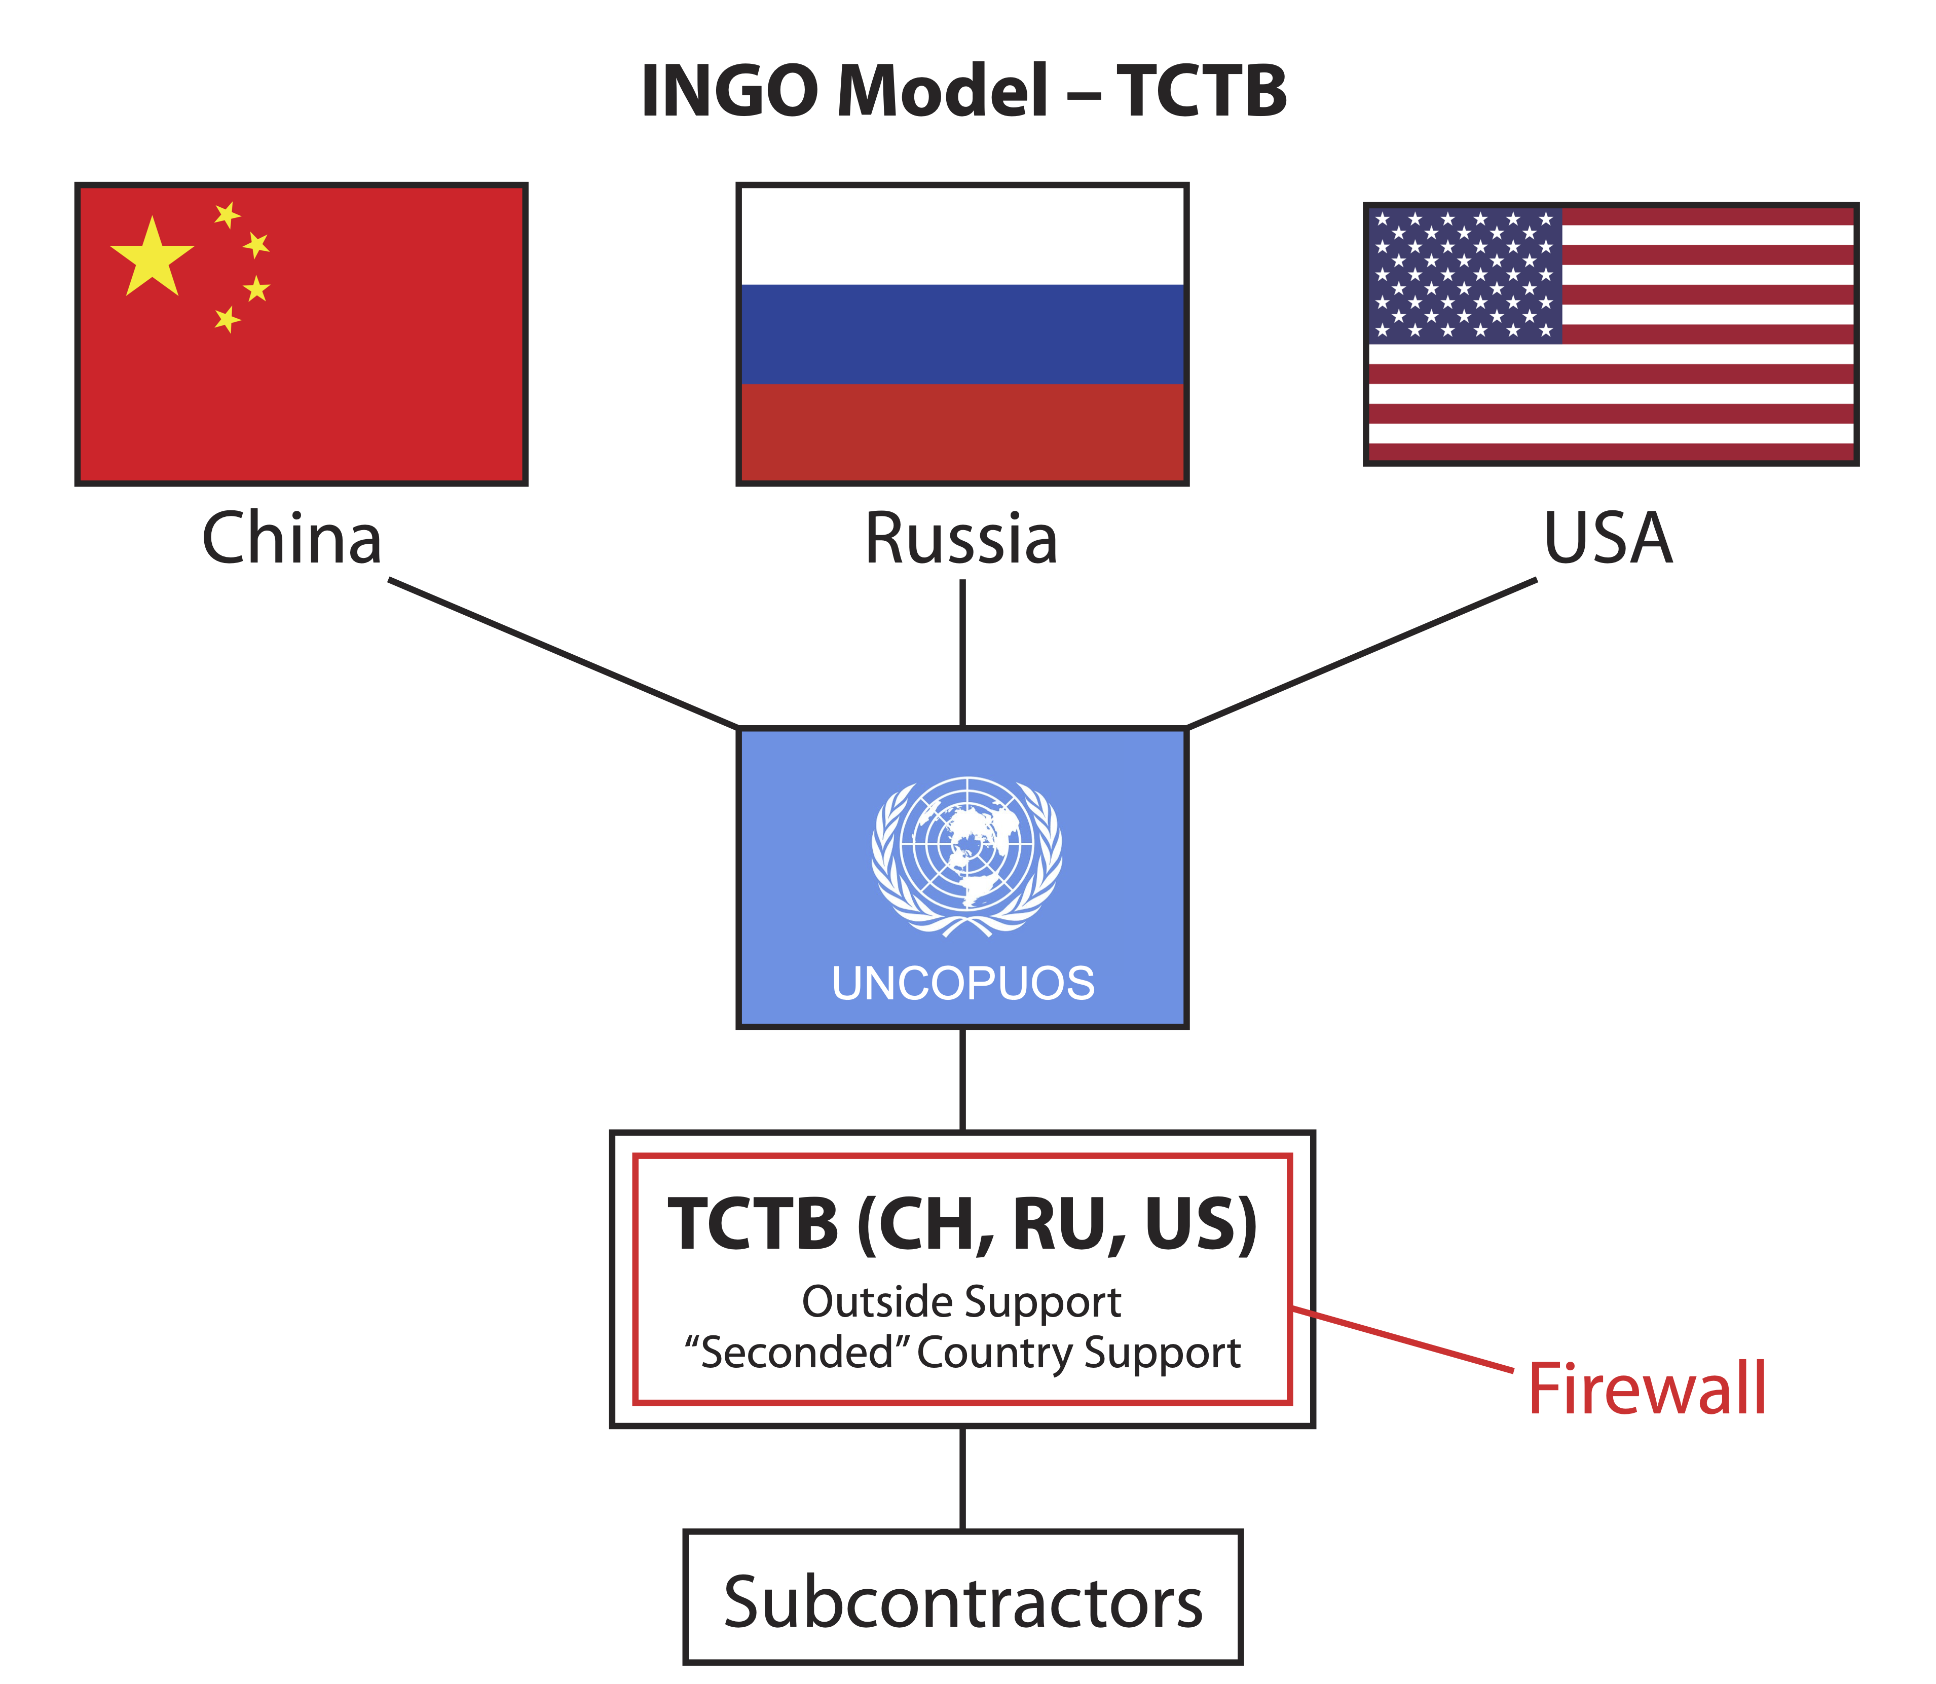
Notes:
Like the Red Cross, but much smaller by design, TCTB is structured to be an overarching umbrella international Non-Governmental Organization (INGO) which will operate through domestic, non-profit subsidiary legal entities in each participating government jurisdiction, providing local accountability, transparency and regulatory oversight of its activities.
TCTB would act as a neutral “mediator” to facilitate cooperation among Russia, China and the US, first by facilitating cooperative planning for remediation missions, and then by managing those cooperative missions under one or more contracts with the UN or with each government.

Slide 10
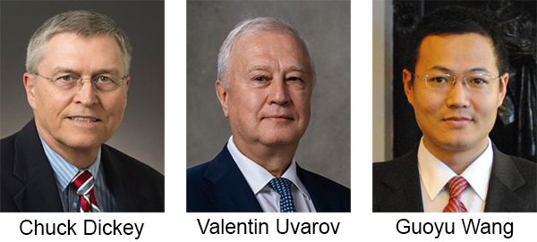
jcdickey@threecountrytrustedbroker.com
uvarov.valent@yandex.ru
wangguoyu1979@126.com
Notes:
My partners, Valentin Uvarov in the Russian Federation and Guoyu Wang in China, are committed to facilitating cooperation among stakeholder governments. We collectively possess broad experience in international and space law, procurement law and planning, international mediation, management systems, government structures, and public-private collaboration. These are exactly the right skills to help governments build a cooperative framework to remediate Massive Derelicts before they begin to collide.

Slide 11
TCTB Advantages and Limitations
TCTB Is:
  The lowest cost alternative
  Neutral and transparent
  Fully compliant with existing local and international law
  Overcomes all legal, political and economic hurdles
  Ready to begin planning now!
TCTB Is Not:
  An obligation to remediate
  A substitute for diplomacy, or political decision-making
  A solution for all types of debris – TCTB’s Proposal is limited to Massive Derelicts
Notes:
Although we are confident that TCTB is the lowest cost, most expeditious path to remediation of Massive Derelicts, it’s important to make clear what we are not. Engaging in our “mediation” process is not an obligation to remediate, but working through our thorough planning process would help inform each delegation of possible hurdles to cooperation and how to overcome them, it could highlight possible differences in approaches, and it could provide insight into how any differences might be reconciled.
It is also important to note that TCTB’s process does not substitute for diplomacy or political decision-making – our process fully respects and incorporates the checks and balances all governments employ. We recognize there is no shortcut for national commitment regardless of the streamlined nature of our planning process. Finally, we acknowledge that TCTB is not a solution for all debris in space – but let’s take care of the most dangerous, before tackling the rest. TCTB is only a tool, nothing more, that governments can use to facilitate cooperation.

Slide 12
Questions?
threecountrytrustedbroker.com
Chuck Dickey (jcdickey@threecountrytrustedbroker.com)
Valentin Uvarov (uvarov.valent@yandex.ru)
Guoyu Wang (wangguoyu1979@126.com)
Notes:
Regardless of the path the world’s governments choose to address the threat we face from orbital debris, Valentin, Guoyu and I are very grateful for the opportunity to present our proposed solution to you. We invite your questions, and we stand ready to assist you. Thank you for your attention.

